Slide 1

PROJECT PRESENTATION
ON
BANKRUPTCY PREVETION
GROUP-1
PRIYANKA
SHREYA A.P
YOGITHA MANI.K
POOJA
SOWMYA
CHETAN PATIL

Slide 2
CONTENTS
OBJECTIVE
DATASET DETAILS
EXPLORATORY DATA ANALYSIS
OUTLIERS OF THE DATA
FEATURE ENGINEERING
MODEL BUILDING
CONCLUSION
MODEL DEPLOYMENT​

Slide 3
OBJECTIVE
The goal here is to model the probability that a business goes bankrupt from different features . This is a classification project the variable to be predicted ( bankruptcy or non- bankruptcy ).The main aim is to build a successful machine learning model that allows the stakeholders to check the status of their business . This will help the stakeholders by providing early warnings , enabling proactive measures to prevent financial distress and to reduce the economic impact of bankruptcy.

Slide 4
DATASET DETAILS
There are 250 rows and 7 columns .The dataset corresponds to the information of bankruptcy and non-bankruptcy.
Industrial risk : 0=low risk, 0.5=medium risk,1=high risk
Management risk : 0=low risk,0.5=medium risk,1=high risk
Financial Flexibility : 0=low flexibility,0.5=medium flexibility,1=high flexibility
Credibility : 0=low credibility,0.5=medium credibility,1=high credibility
Competitiveness :0=low competitiveness,0.5=medium competitiveness,1=high competitiveness
Operating risk: 0=low risk,0.5=medium risk,1=high risk
Class: bankruptcy , non-bankruptcy (target variable )

Slide 5
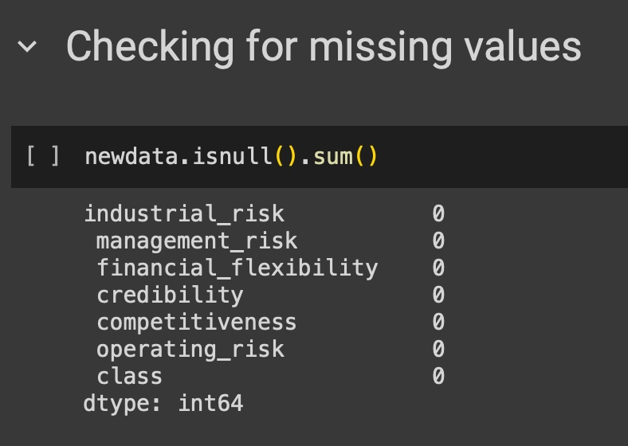
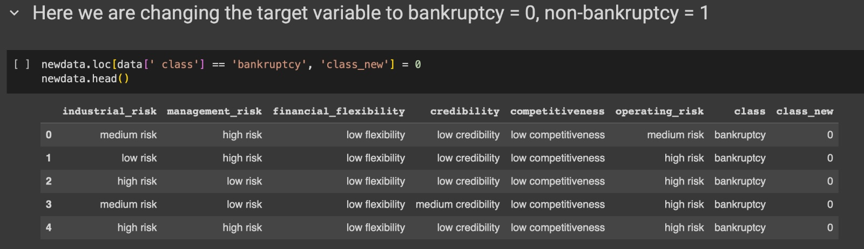
Exploratory data analysis
Checking for missing values.
Changing the target variable to bankruptcy = 0,non –bankruptcy = 1.

Slide 6
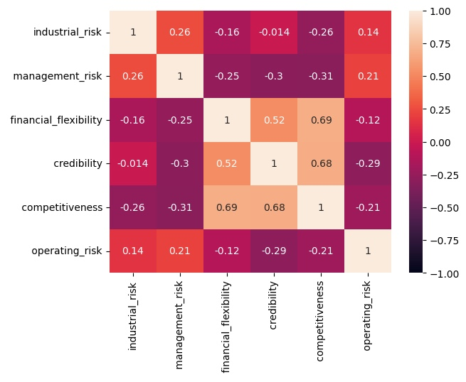
Exploratory data analysis
Correlation heatmap for the numerical data.

Slide 7
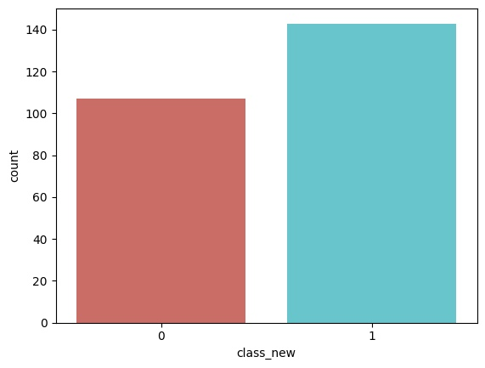
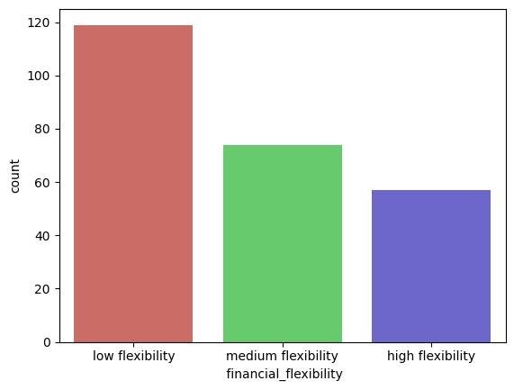
Exploratory data analysis
COUNT PLOT
The risk of bankruptcy is low
The company cannot easily rely on its funds as the count of low flexibility is high

Slide 8
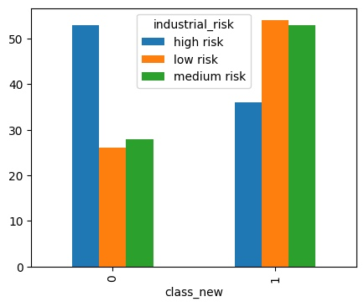
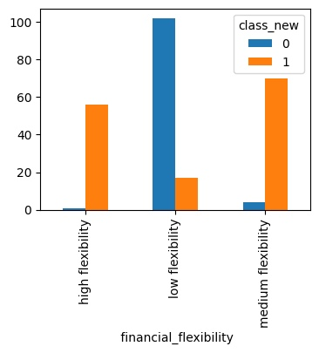
Exploratory data analysis
The risk of company going bankrupt is high
Whenever flexibility is more the chances of bankruptcy is less and vice versa is also true.

Slide 9
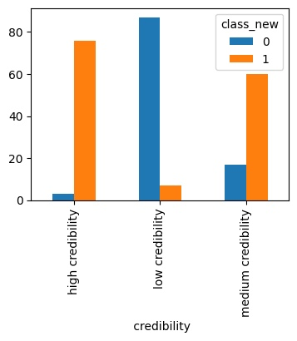
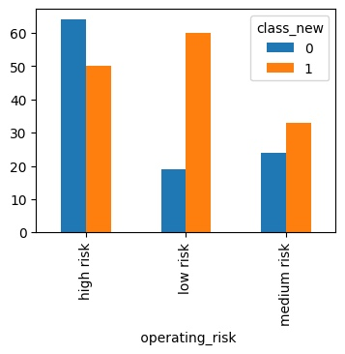
Exploratory data analysis
Whenever operating risk is more the chances of bankruptcy is more and when operating risk is medium or low there is less chances of bankruptcy compare to high operating risk.
Whenever credibility is more the chances of bankruptcy is less and vice versa is also true.

Slide 10
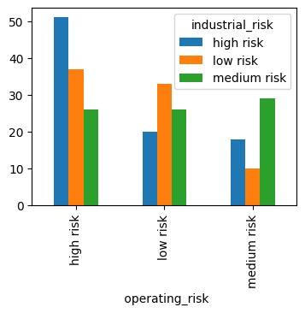
Exploratory data analysis
When industrial risk is high then operating risk is also high and when industrial risk is low or medium the operating risk is also decreases.

Slide 11
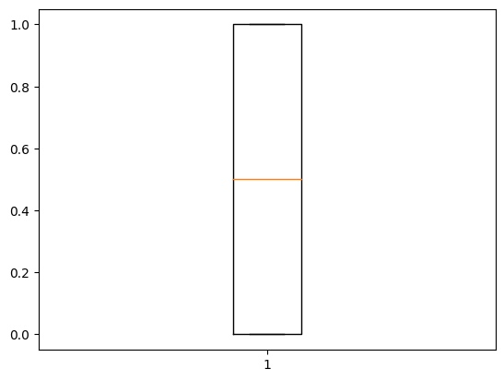
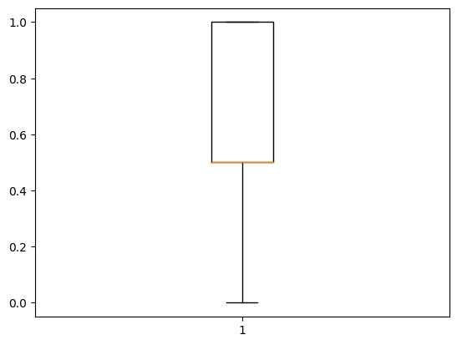
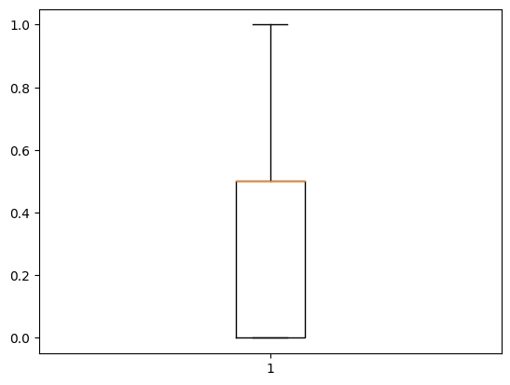
OUTLIER DETECTION
Management risk
Financial flexibility
Industrial risk
Credibility
Competitiveness
Operating risk

Slide 12
FEATURE ENGiNEeRING
Techniques of feature engineering adopted in this project are :
ExtraTreesClassifier
SelectKBest

Slide 13
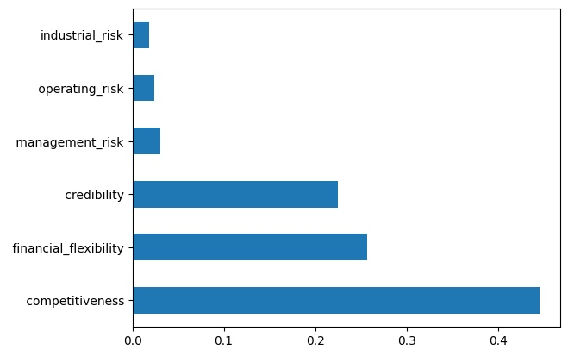
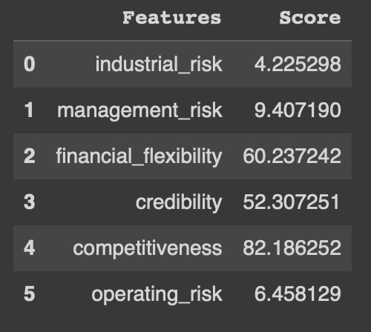
Feature engineering
ExtraTrees Classifier
SelectKBest

Slide 14
MODEL BUILDING
Importing the required libraries
Getting X and Y Variables
Splitting the dataset into Train and Test sets
Building the models on : Logistic Regression , KNN , Naive Bayes Classifier(Gaussian NB and Multinomial NB) , Support Vector Machine , Decision Tree Classifier , Random Forest Classifier , Bagging Classifier , Gradient Boosting Classifier , AdaBoostClassifier , Neural Network
Comparing the cross validation scores for all above applied models

Slide 15
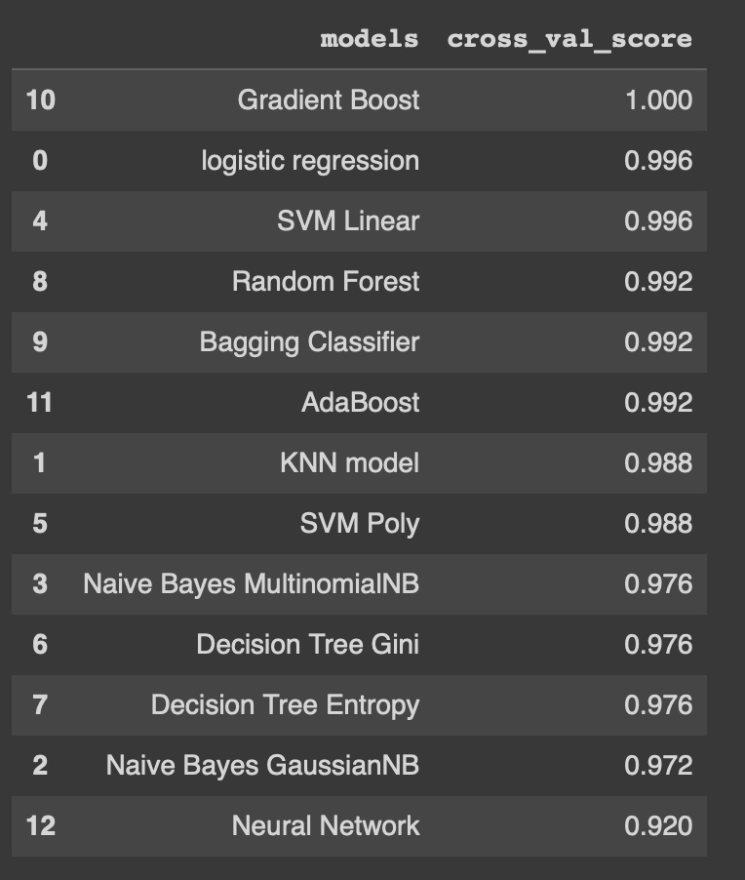
MODEL BUILDING

Slide 16
CONclusION
Among all the other models , only Gradient Boost Model has the best cross validation score .Hence, it is considered to be the best model for predicting the target variable .
Gradient Boost model is chosen for further deployment of the project.

Slide 17
DEPLOYMENT
Streamlit is used for deploying the model
HTML is used for designing the page
Localtunnel is used for easy usage of web services on the local computer

Slide 18
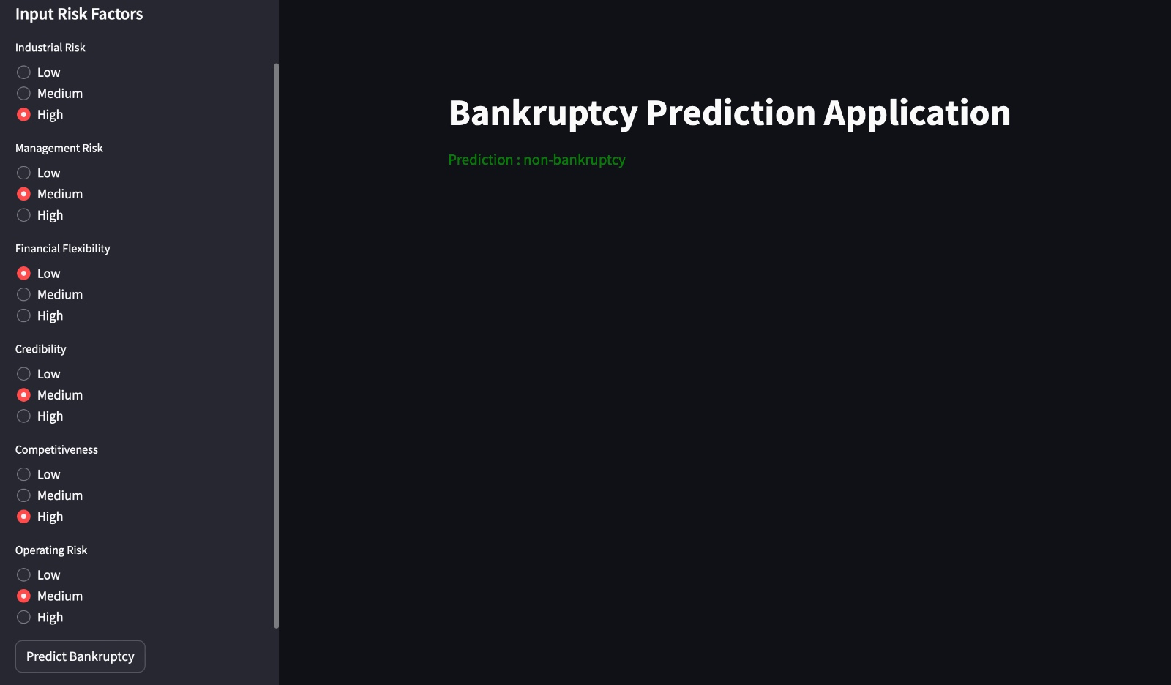
DEPLOYMENT

Slide 19
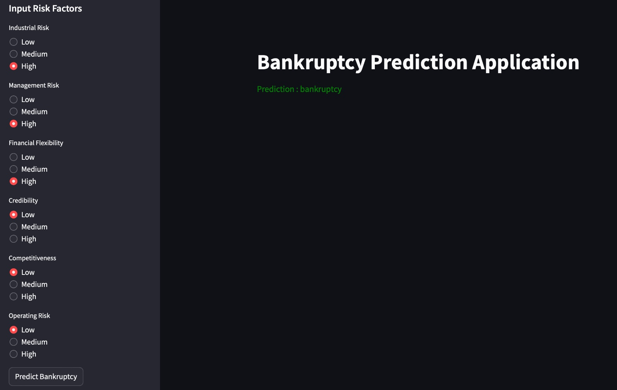
DEPLOYMENT

Slide 20
THANK YOU

